Slide 1
Ocean’s Seven
Critical Design Review
Hassan Alahmed | Abbigail Caballero
Kyle Harlow | Daniel Henderson
Yuvin Kokuhennadige | Cassandra Noice
University of Colorado, Boulder
31 January 2017
-1

Slide 2
Agenda
Project Specifications
Motivation
Objectives
Adjustments
Systems Design and Functionality
Merge Circuit
Power Conversion
Backplane
Controls
Software
Project Management
Budget
Schedule
Risks
Additional Information

Slide 3
1.0 Project Specifications

Slide 4
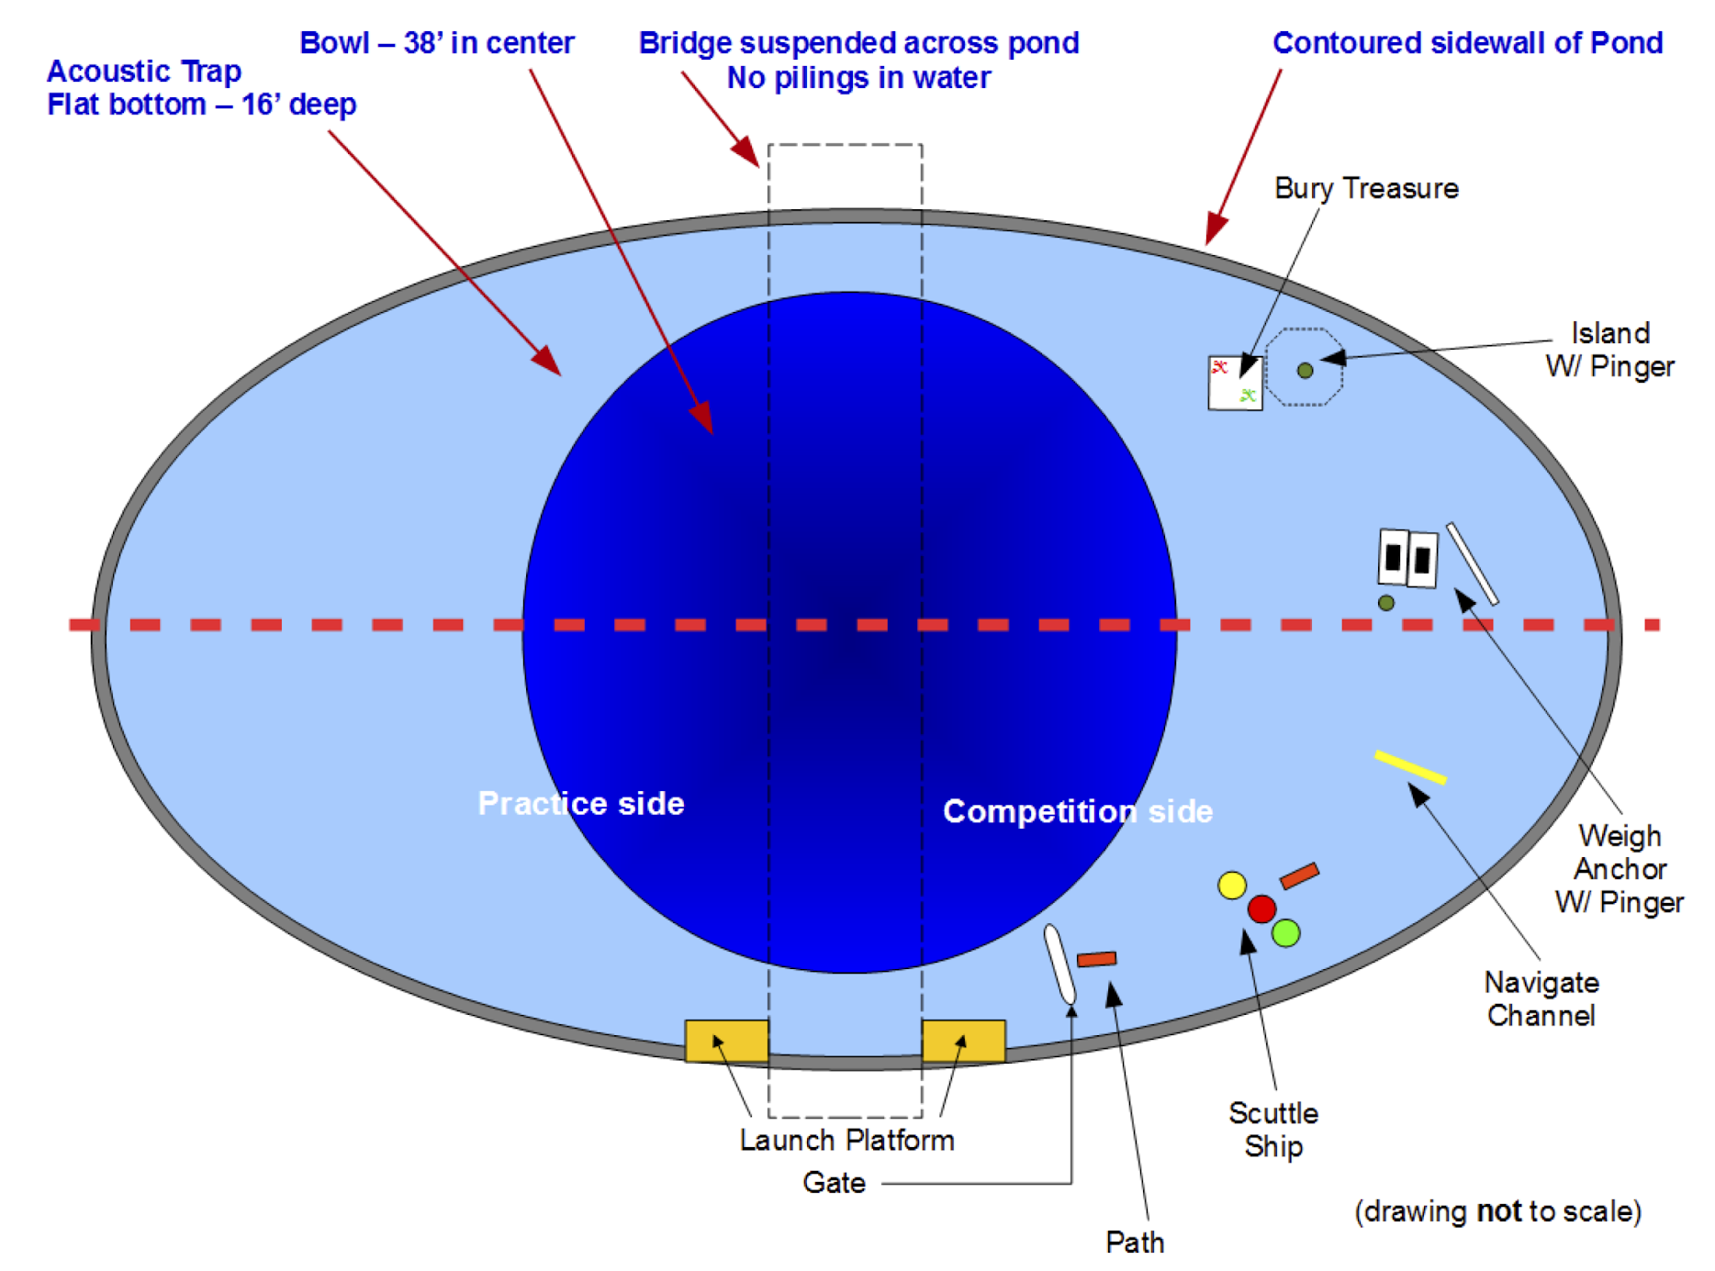

Slide 5
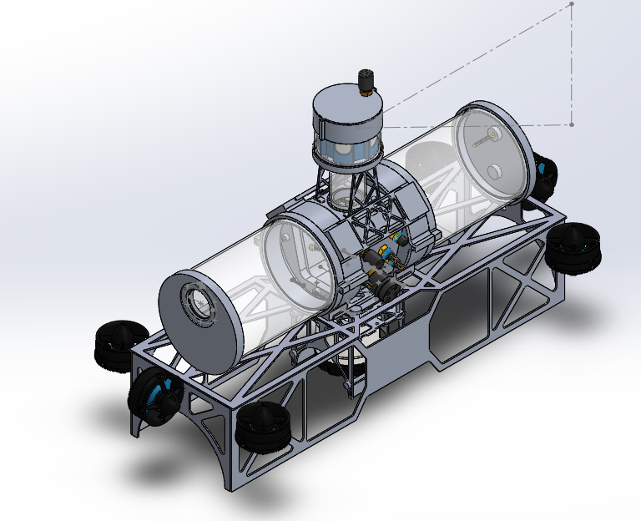
Approximate Mechanical Design

Slide 6
Electrical Design
2 x 14.8V, 10C, 10Ah, Multistar Li-Po batteries
2 x 4 High Power SubConn Connectors (Batteries)
3 x SubConn Ethernet Connectors (POE Camera, DVL, 1 Extra)
3 x 4 Pin SubConn Connectors (Actuators/Hydrophones)
8 x 3 Pin SubConn Connectors (Motors)

Slide 7
Objectives
•Develop a control system on a microcontroller.
–Manage 8 PWM driven motors
–Pitch, roll, yaw, depth, speed stability
•Develop circuit and supporting hardware to merge two 14.8V 100A LiPo Batteries into one 14.8V 200A line
•Develop power conversion circuits
–12.8A 14.8V input
–5V, 12V, 19V, 48V output lines between 1-4A
•Develop backplane PCB to simplify connection of all current and future PCBs for the submarine

Slide 8
Reasoning and Applications
Mitigate technical and user faults experienced by past CU Robotics RoboSub teams
wire management
inefficient motor controller
difficulties in component repair/replacement
Modular systems development

Slide 9
Adjustments: Backplane
1. Remove Communication Lines
Justification: CPU handles peripherals, only one Communication line needed, avoid EM pitfalls
2. Merge circuit placed on stand alone PCB
Justification: Circuit is most susceptible to damage. Replacing merge circuit simplified and reduce costs
3. Eliminate central backplane board
Justification: Space constraints makes a central board unfeasible.

Slide 10
Adjustments: Controls
1. Removed navigation system
Justification: Implementation unfeasible in allotted time
2. Redefined control system responsibilities, 2x SISO, 1x MIMO, removed option for H₂/H_{inf}
Justification: Simplify controller design
3. Moved peripheral drivers to main cpu
Justification: cpu is better equipped to handle data, perform initial integration, limits number of communication channels on the PCB

Slide 11
Adjustments: Power Systems
1. Dropped 3.3V, 24V rails
Justification: No longer required by client.
2. Added 12V rail
Justification: Required by client for electromechanical actuators
3. Distributed current sensing
Justification: Removes single point of failure, gives more information about system

Slide 12
2.0 Design and Functionality

Slide 13
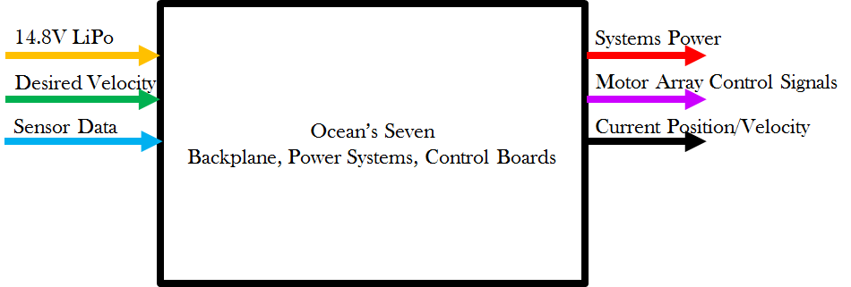
Functional Decomposition, Level 0

Slide 14
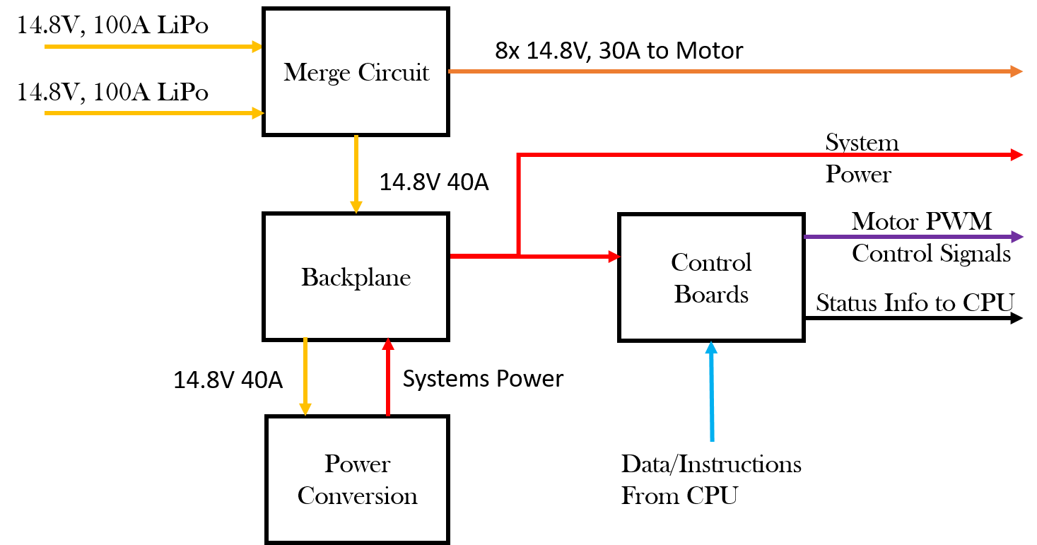
Functional Decomposition, Level 1

Slide 15
Merge Circuit

Slide 16
Requirements and Specifications
Requirements:
Current controlled positive high voltage ideal diode controller (Current merge circuit) to get a 200A output
Current sensing
14.8V, 140A output for motors through kill switch to turn off the motors for safety
Specifications:
LTC4357 Positive High Voltage Diode Controller
Current sensing: Teensy and AD8217 Zero-Drift Current Shunt Monitor
Kill Switch: Infineon OptiMOSTM Power-MOSFET, 30V

Slide 17
FD Level 2, Merge Circuit

Slide 18
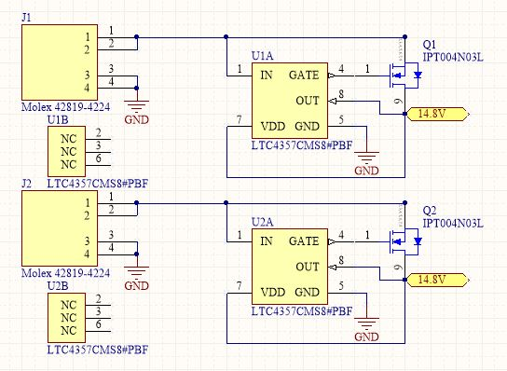
Merge Circuit Schematic

Slide 19
Power Conversion
Notes:
*Vehicle requires 6 different power outputs, 5 of which we need to either boost or buck.
*So, let’s get started with the requirements

Slide 20
Requirements
Power Outputs:
48V, 0.5A (PoE for a camera)
48V, 1A (DVL)
19V, 4A isolated (CPU)
12V, 3A (electromechanical actuators)
5V, 1A (digital components)
Current sensing for each output
Notes:
Hassan
*The first requirement is consisted of five power outputs:
-The first is a 48 volt, half an amp line for a camera, (it is going to be a power over ethernet line)
-The second output is also a 48V line, but this time we need one amp. This line is required to power a doppler velocity log
-The third is an isolated …
-EA in the vehicle requires 12V and 3A, that’s where the fourth power output comes in
-Last but not least is the 5 volt one amps converter that will be powering a bunch of digital components like the IMU(inertial measurement unit), Hydrophones and other controls system parts
*Current sensors because:
-We don’t want to run 200 Amps through one sensing resistor. It creates a single point of failure.
-Also, it is more beneficial for us to have a sensor per each output because it helps us in debugging. For Example, if we had a railing issue, we could easily identify which line is causing it

Slide 21
FD Level 2, Power
Notes:
Hassan

Slide 22
Power Specifications
48.0V: LT3958 High Efficiency, Switching Boost Converter
19.0V: LTC3780 High Efficiency, Switching Boost Converter
12.0V: LTC3780 High Efficiency, Switching Buck Converter
5.0V: Recom R-78E5.0-1.0 Switching Regulator
Current sensing: Teensy and AD8217 Zero-Drift Current Shunt Monitors
Notes:
Hassan

Slide 23
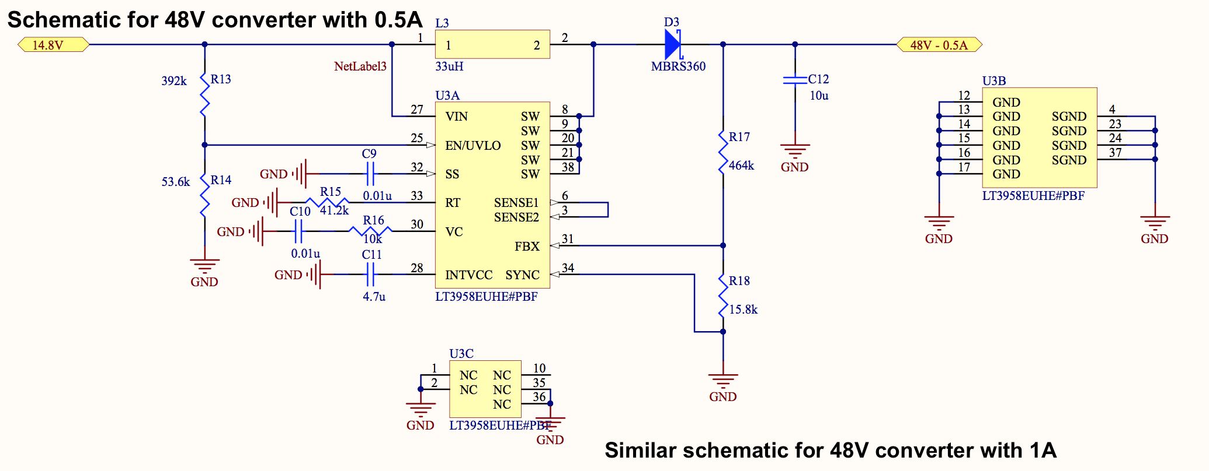
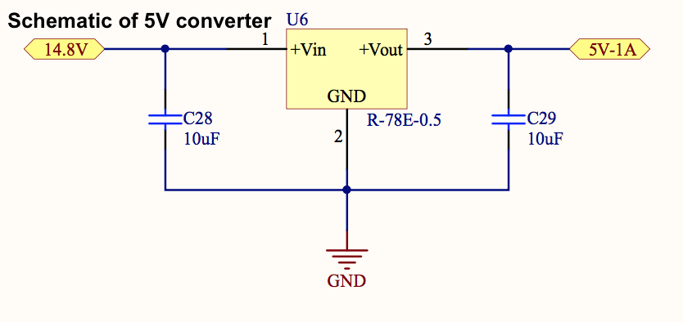
Schematic, 14.8V to 48V
Notes:
Hassan

Slide 24
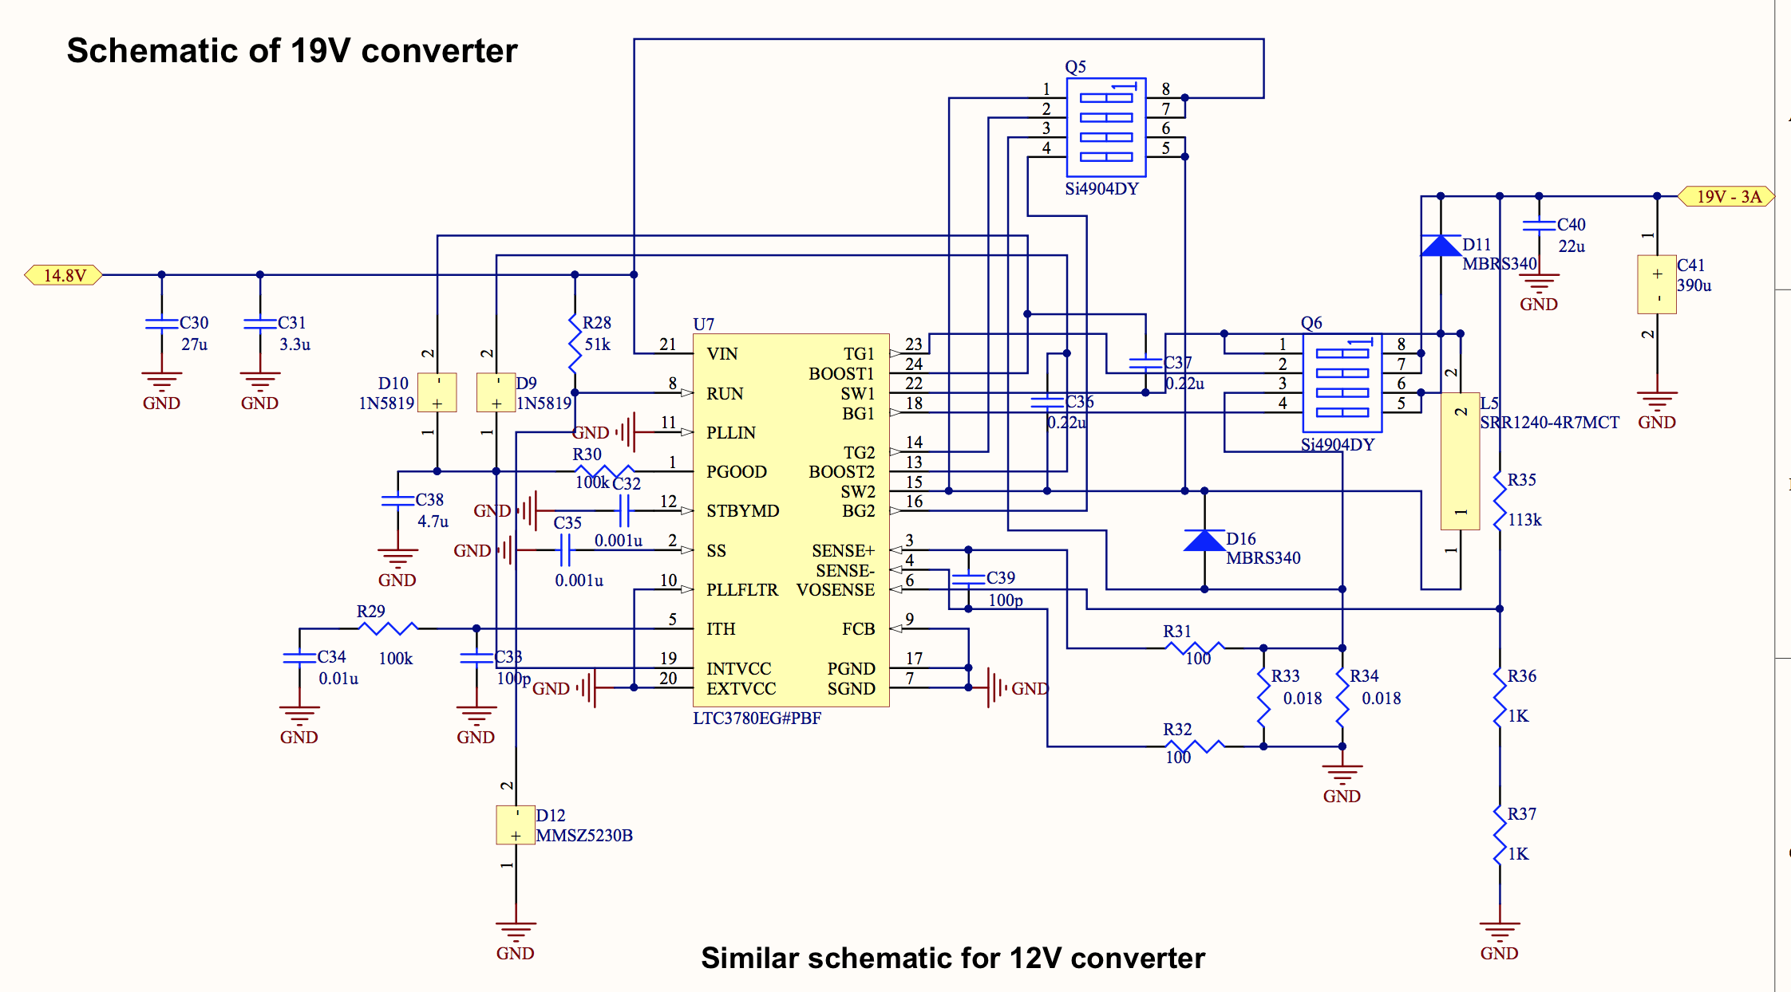
Schematic, 14.8V to 19V
Notes:
Hassan
*POC Schematics, going to be updated
*Same circuit for the 12V converter, but with different passive components

Slide 25
Backplane

Slide 26
Subsystem Design: Backplane
Requirements:
Take in 14.8V, 40A from current merge circuit
Deliver 5V, 12V, 19V, and 48V outputs from the power board to the controls system, CPU, and sensors
Provide PWM from the controls system to ESCs
Provide connectivity and stability to merge board, ESC holders, control board, power conversion board

Slide 27
Specifications
Wire-to-board connectors
ESCs: 8x3 Pin Headers,
5V, PWM Signal, Ground
Digital Components: Molex Nano-Fit Power Connectors
6x5V outputs
Actuators: Nano-Fit Power Connectors
2x12V outputs
1x CPU: Molex Nano-Fit Power Connectors
2x19V output
1x DVL, and 1x Power Over Ethernet
2x48V output

Slide 28
Specifications, Cont’d
Board-to-Board Connectors
Merge Circuit:
Molex ExtremePower Edge Connector
2x Power Segment
ESC Holders
Molex ExtremePower Edge Connector
Control Board
Molex ExtremePower Edge Connector
1x Power Segment, 1x Data Segment
Power Conversion Board
Molex ExtremePower Edge Connector
6x Power Segments

Slide 29
Control Systems

Slide 30
Hardware Requirements
Connect to backplane via board to board connector
Communicate with CPU via USB
Visual debugging outputs
Output 8 PWM signals

Slide 31
FD: Level 2, Controls

Slide 32
Hardware Specifications
STM32F767 Cortex M7 microcontroller
ST-LINK programmer (JTAG header)
FT232RL UART/USB for cpu
Slot connection
8xPWM output (slot contacts)
Reset button
Status LEDs (per PWM)
TI LM3940 Lin. Reg. (5V to 3.3V)

Slide 33
Controls Algorithm Requirements
Yaw position, err < 1%
Heading Speed, err < 1%
Roll position, err < 0.3%
Pitch position, err < 0.3%
Depth position, err < 0.1%
Reject step disturbances

Slide 34
Control Algorithms Approach
Yaw as a system:
2 motors to control
Independent of other controllers
Speed as a system
2 motors
Independent
Pitch, Roll, Depth as a system
4 motors
interdependent

Slide 35
Yaw Control
Actual drag term: - (Kd/2)(θ’)^2
Approximation: (θ’)^2 ≅ A*θ’

Slide 36
Speed Control
Actual drag term: - (Kd/2)(H’)^2
Approximation: (θ’)^2 ≅ A*H’

Slide 37
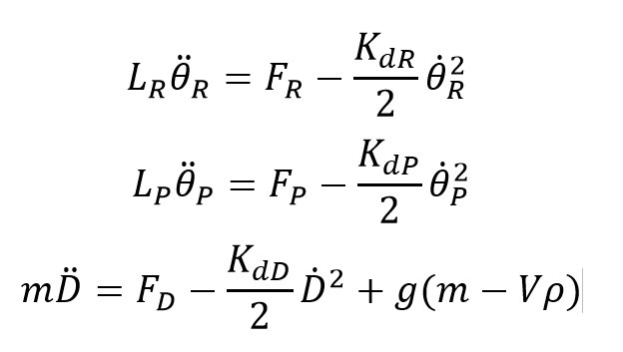
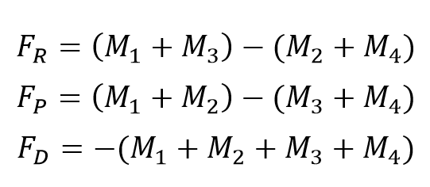
Pitch, Roll, Depth Control
M1
M2
M3
M4

Slide 38
Sensors Performance
DVL:
Ping rate: 8Hz
Long term velocity accuracy: 0.1cm/s
IMU:
Data acquisition: 400Hz
Gyroscope resolution: 0.06°/s
Accelerometer resolution: 490μg

Slide 39
Software

Slide 40
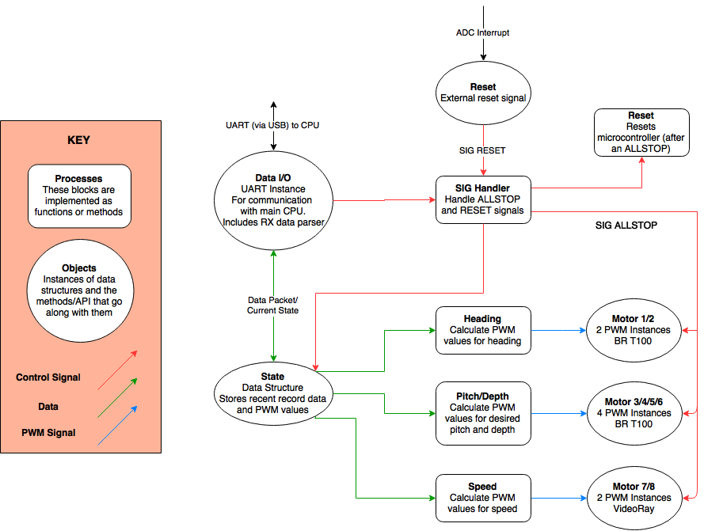
Software Design

Slide 41
Software Design
Controls Software:
Primarily interrupt-based
Combination of mathematics and states
Additional Software: Current Sensing
2x Teensy 3.2
Plug directly into cpu
Poll 5 ADC ch. (power conv. circuits)
Poll 8 ADC ch. (motor current), 2 ADC ch. (power/controls boards), 1 comparator input for kill switch
Send kill switch signal to cpu (in turn, to controls board)
Notes:
Note: languages - C (arduino C for teensy), IDE - SW4STM and TeensyDuino
STM HAL library used

Slide 42
3.0 Project Management

Slide 43
Division of Labor
Kyle (Power and Controls) | Project Co-Lead, Robosub Liaison, Design Point Person, Merge Circuit Board Design
Cassandra (Controls) | Project Co-Lead, Chief Administrator, Controls Board Design, Controls Algorithms
Abby (Controls) | Controls Board Design, Controls Algorithms, Motor SysID
Daniel (Controls) | Budgeteer, Controls Board Design, Controller Software, Manage Ordering Materials for Controls
Hasan (Power) | Backplane Design, Manage Ordering Power Parts
Yuvin (Power) | Converter Board Design, Order Power PCBs

Slide 44
Power & Backplane Budget
Item | Price ($) | Quantity | Subtotal ($)
2-layer PCB | 33 | 3 (x3 revisions) | 297
Power MOSFETs | 6 | 12 | 76
Teensy 3.2 | 20 | 1 | 20
DC/DC converters | 6 | 12 | 72
LiPo batteries | 100 | 6 | -
Molex Connectors | 8 | 12 | -
Misc Parts (ICs, resistors, capacitors, connectors) | - | - | 160
Shipping | 100 | - | 100
TOTAL = $ 725

Slide 45
Controls Budget
Item | Price ($) | Quantity | Subtotal ($)
Microcontroller | 15.98 | 3 | 47.94
STM32 Development Board | 50 | 1 | 50
2-layer PCB | 43 | 1 (x3 revisions) | 129
FT232 | 4.50 | 3 | 13.50
ST-LINK | 22.61 | 1 | 22.61
Misc. Parts & Connectors | - | - | 60
Shipping | 40 | - | 40
TOTAL = $ 363.05

Slide 46
Overall Budget
Item | Subtotal ($)
Power & Backplane Subsystems | 725
Controls Subsystem | 363.05
Misc. Parts & Connectors | 60
TOTAL = $1148.05

Slide 47
Schedule
2.14 | Characterize motors Complete all PCB schematics, layouts Write testing plans Deadline: order all PCBs, rev A
3.9 | All boards populated and tested Integration testing completed Respin boards if necessary
4.20 | Tune controllers Continue testing on submarine Order/populate PCBs rev C if necessary
5.4 | Final testing/verification Prepare presentation Senior Design EXPO

Slide 48
Risks
Risks | Contingency Plan
Mechanical team not completing robot in sufficient time for integration testing | We need to do as much integration testing outside the water as possible, and be prepared for long hours of testing/tuning in a pool
Current linearizations may be insufficient for actual model of the system | We would have to create a better linearization that would likely be more complex
PCB delamination due to high temperatures within the UAV | Epoxy the entire board
Unable to purchase certain necessary sensors, we must not break the ones we already have | Send parts back to manufacturer for repair
Need to coordinate with other teams for integration, this usually causes unforeseen issues | Lots of communication and plan as much time as possible for integration

Slide 49
Questions?

Slide 50
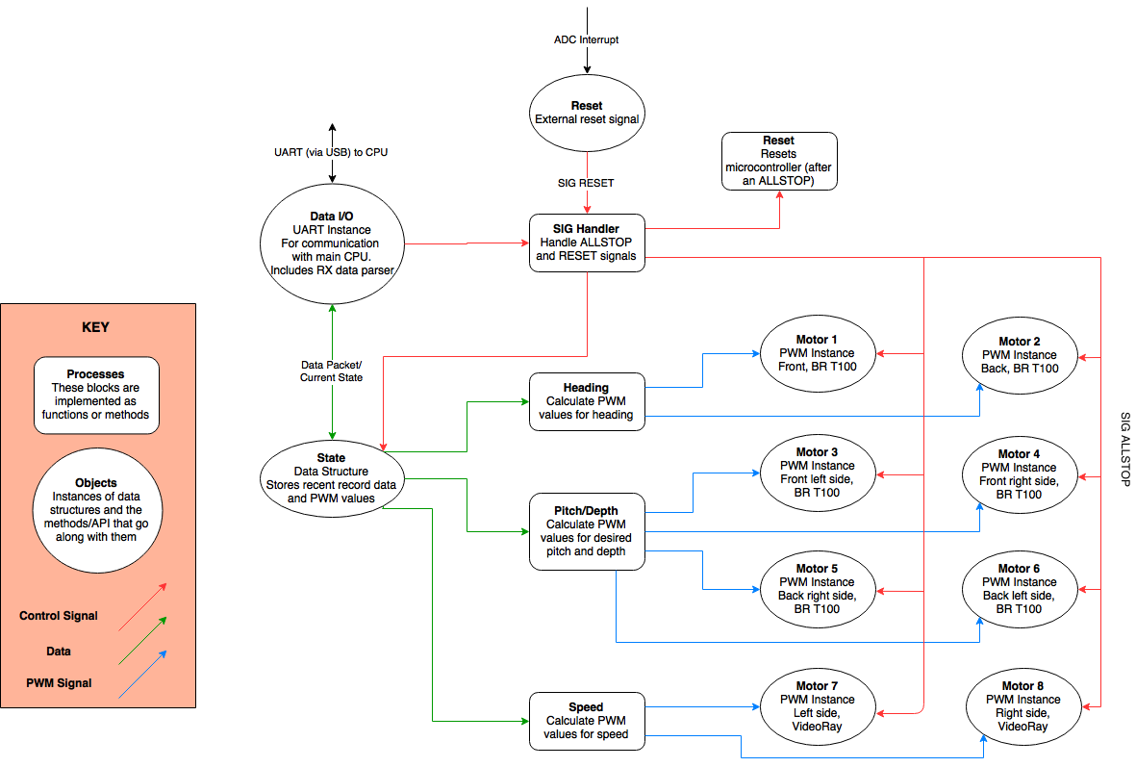
Software Design

Slide 51
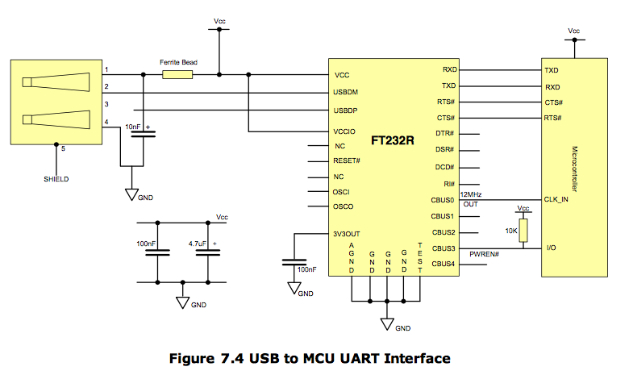
FT232 - MCU

Slide 52
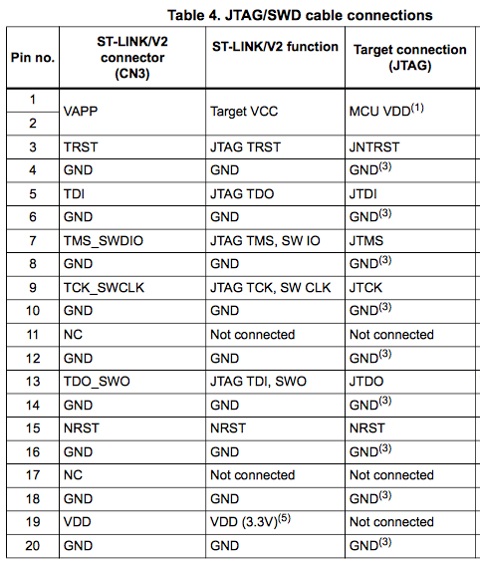
ST-Link JTAG connectivity

Slide 53
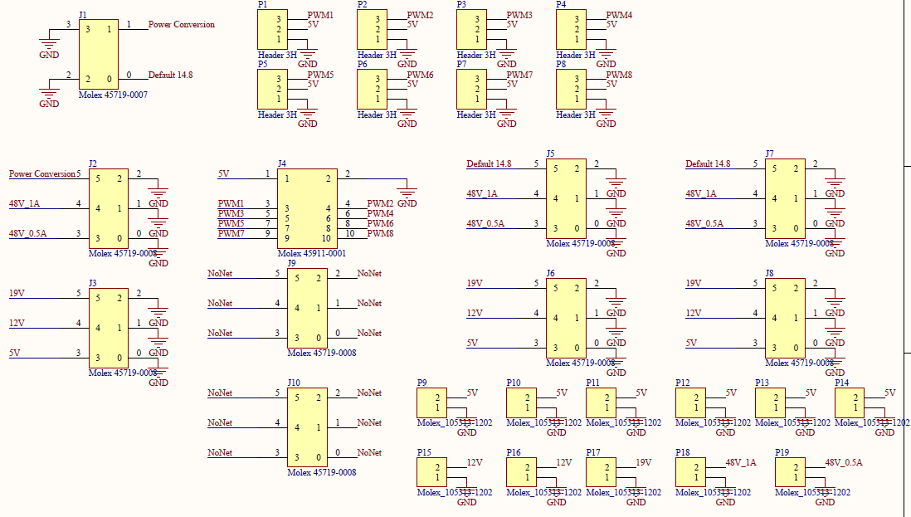
Schematic, Backplane

Slide 54
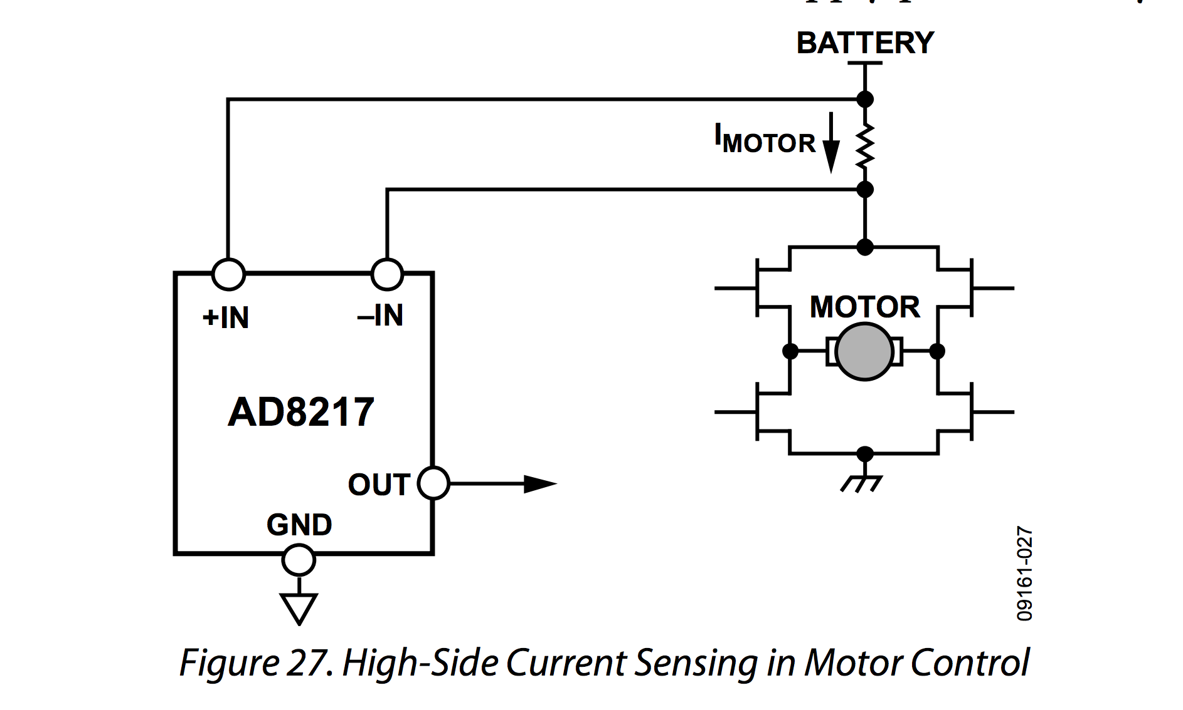
AD 8217

